Slide 1


Mini Project – Cyber Security Tools MP11
Submitted By -
Anirudh Kumar Kushwaha
181500093
Section - K
Submitted To -
Mr. Piyush Vashishth

Slide 2


Why is it important?
Let’s face it, we live in a digital world. Our work lives, personal lives, and finances have all begun gravitating toward the world of the internet, mobile computing, and electronic media. Unfortunately, this widespread phenomenon makes us more vulnerable than ever to malicious attacks, invasions of privacy, fraud, and other such unpleasantries.
That’s why cybersecurity is such a vital part of a secure and well-ordered digital world. Cybersecurity keeps us safe from hackers, cyber criminals, and other agents of fraud. But how good is your cybersecurity knowledge?

Slide 3
About the Project
My project consists of following tools :-
MAC Chager (Changes your MAC address)
ARP Spoofer (Changes ARP table of gateway and a PC on the network, making you the MITM)
Network Scanner (Checks all live hosts in a given IP range)
Spider (Recursively keeps finding links from a website)
Crawler (Finds subdomains and links given on them)

Slide 4
More about Tools
1. MAC Changer :-
Theoretically, every network device in the world is identified by a MAC address. But not every user wants this transparency on the internet. One reason to mask your MAC address is for the protection of privacy – for example, in public WLAN networks. This legitimate use of MAC spoofing is in opposition to the illegal activities, where users change MAC addresses to circumvent access restrictions and security measures or imitate the identity of another network device.

Slide 5
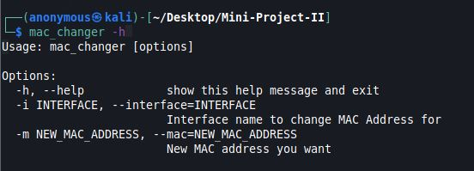
MAC Changer :

Slide 6
More about Tools
2. ARP Spoofer :-
An ARP spoofing man in the middle attack (MitM), sometimes referred to as an ARP poisoning attack, is one where attackers exploit the Address Resolution Protocol (ARP) in order to intercept all communications between two devices on the same network.

Slide 7
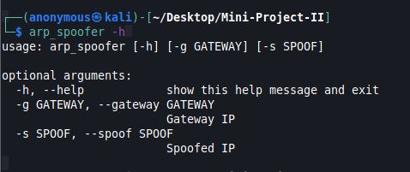
ARP Spoofer :

Slide 8
More about Tools
3. Network Scanner :-
Network scanning may be defined as a surveillance technique, which is used in order to locate the live hosts available on a particular network. Network administrator, penetration tester or a hacker can use this technique. We can configure the network scanner according to our requirements to get maximum information from the target network.

Slide 9
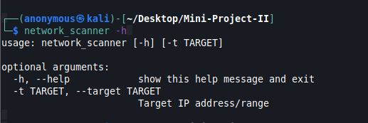
Network Scanner :

Slide 10
More about Tools
4. Spider:-
Crawler and Spider are basically the same thing since Spiders "CRAWL" webpages. In our case, where Crawler was finding subdomain and extracting links from them, Spider would recursively keep finding links from a given website.

Slide 11
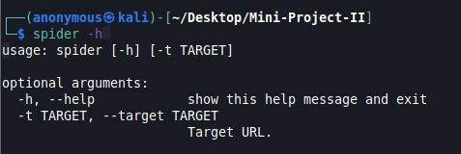
Spider :

Slide 12
More about Tools
5. Crawler:-
A crawler is a specialized software designed to systematically crawl and browse the World Wide Web usually for the purpose of indexing Web pages in order to provide them as search results for user search queries. In our scenario, it finds a list active subdomain for a given website and extracts links from them.

Slide 13
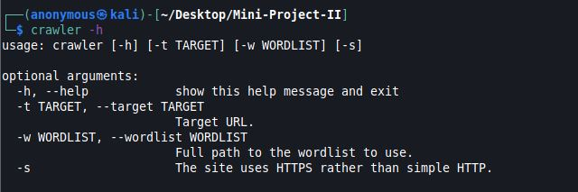
Crawler :

Slide 14

THANK YOU!

